Slide 1

CSC- 362 Computer Networks Week-7 Lecture-13-14
Prepared by:
Mr. Attique Ur Rehman

Slide 2
Instructor Contact Details
Name: Mr. Attique Ur Rehman
Course Instructor: CSC362- Computer Networks
Credit Hours: (3+1)=4
Office Location: 2nd Floor Computer Science Faculty Office: 41-C
Email: attique.rehman@lgu.edu.pk
Visiting Hours: Wednesday (11:30 am -1:00 pm)

Slide 3
Course Material
Reference books
Many textbooks on Networking may be consulted
Research papers!
RFCs and Internet drafts
Related to TCP/IP suite and other protocols
Web resources
Tutorials, white papers, reports, etc.

Slide 4
Text Book
Computer Networks: A Systems Approach by Larry L. Peterson and Bruce S. Davies.
Third Edition [2003], Morgan Kaufmann Publishers, San Mateo, California, USA
Computer Networks by Andrew S. Tanenbaum
Fifth Edition
Data Communication and Computer Networks, by Behrouz A. Forouzan
5th Edition
Data and Computer Communications by William Stallings
10th Edition
Computer Networking: A Top-Down Approach Featuring the Internet by James F. Kurose and Keith W. Ross
6th edition

Slide 5
IEEE STANDARDS
In 1985, the Computer Society of the IEEE started a project, called Project 802, to set standards to enable intercommunication among equipment from a variety of manufacturers. Project 802 is a way of specifying functions of the physical layer and the data link layer of major LAN protocols.
Topics discussed in this section:
Data Link Layer Physical Layer

Slide 6
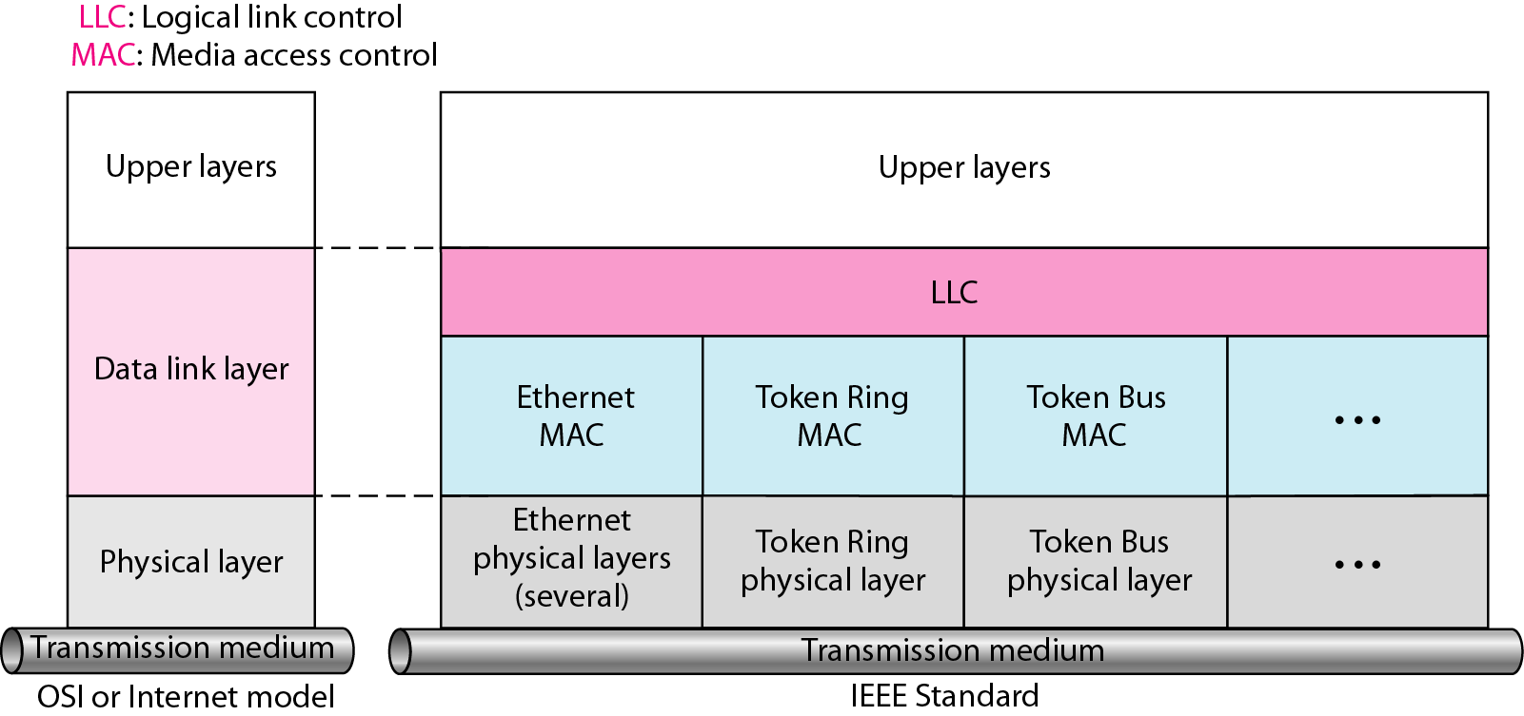
IEEE standard for LANs

Slide 7
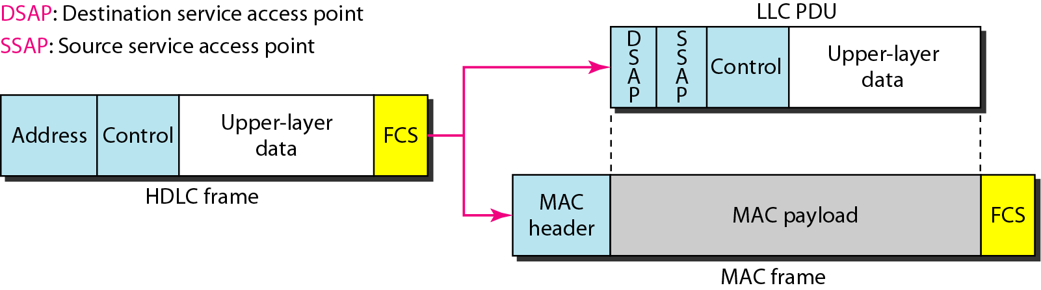
HDLC frame compared with LLC and MAC frames

Slide 8
STANDARD ETHERNET
The original Ethernet was created in 1976 at Xerox’s Palo Alto Research Center (PARC). Since then, it has gone through four generations. We briefly discuss the Standard (or traditional) Ethernet in this section.
Topics discussed in this section:
MAC Sublayer Physical Layer

Slide 9
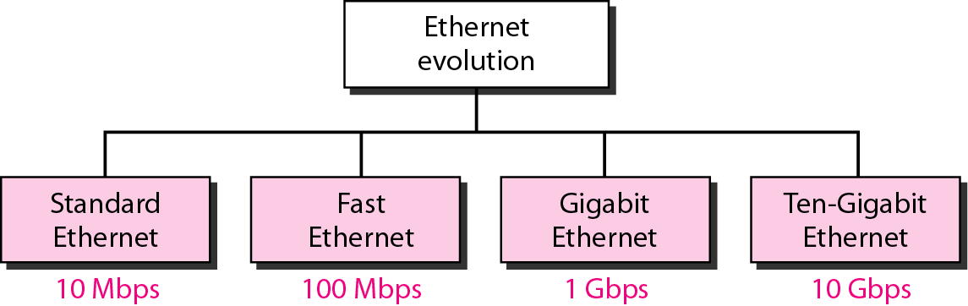
Ethernet evolution through four generations

Slide 10
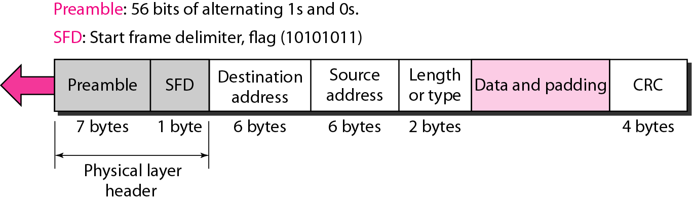
802.3 MAC frame

Slide 11
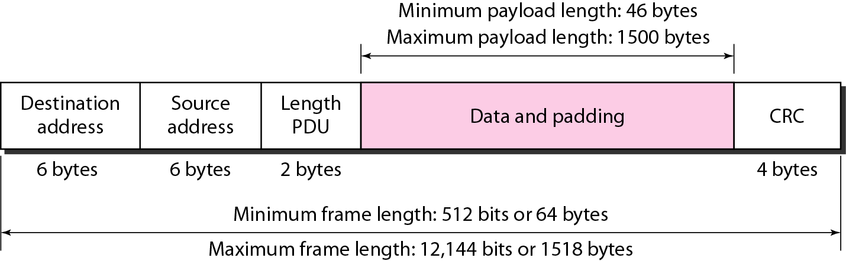
Minimum and maximum lengths

Slide 12

Note
Frame length:
Minimum: 64 bytes (512 bits) Maximum: 1518 bytes (12,144 bits)

Slide 13
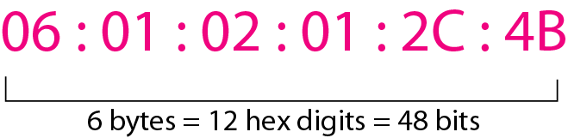
Example of an Ethernet address in hexadecimal notation

Slide 14
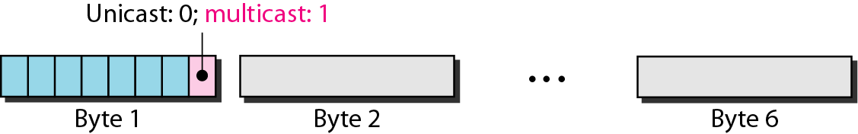
Unicast and multicast addresses

Slide 15
Note
The least significant bit of the first byte defines the type of address. If the bit is 0, the address is unicast; otherwise, it is multicast.

Slide 16
Note
The broadcast destination address is a special case of the multicast address in which all bits are 1s.

Slide 17
Define the type of the following destination addresses:
a. 4A:30:10:21:10:1A b. 47:20:1B:2E:08:EE
c. FF:FF:FF:FF:FF:FF
Solution
To find the type of the address, we need to look at the second hexadecimal digit from the left. If it is even, the address is unicast. If it is odd, the address is multicast. If all digits are F’s, the address is broadcast. Therefore, we have the following:
a. This is a unicast address because A in binary is 1010.
b. This is a multicast address because 7 in binary is 0111.
c. This is a broadcast address because all digits are F’s.

Slide 18
Show how the address 47:20:1B:2E:08:EE is sent out on line.
Solution
The address is sent left-to-right, byte by byte; for each byte, it is sent right-to-left, bit by bit, as shown below:

Slide 19
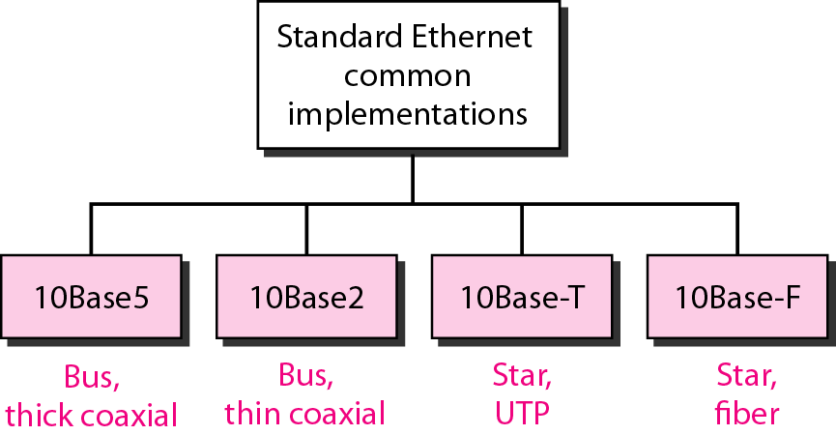
Categories of Standard Ethernet

Slide 20
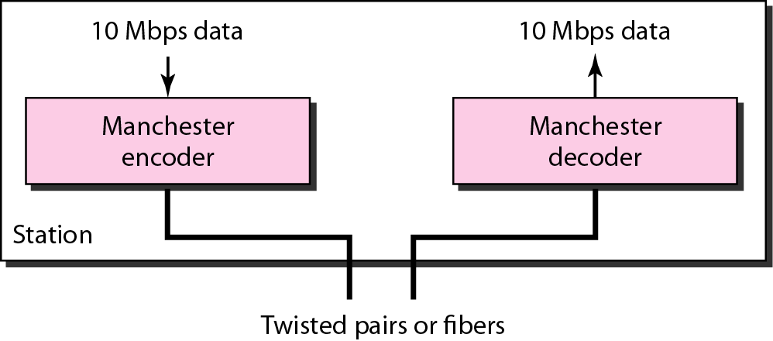
Encoding in a Standard Ethernet implementation

Slide 21
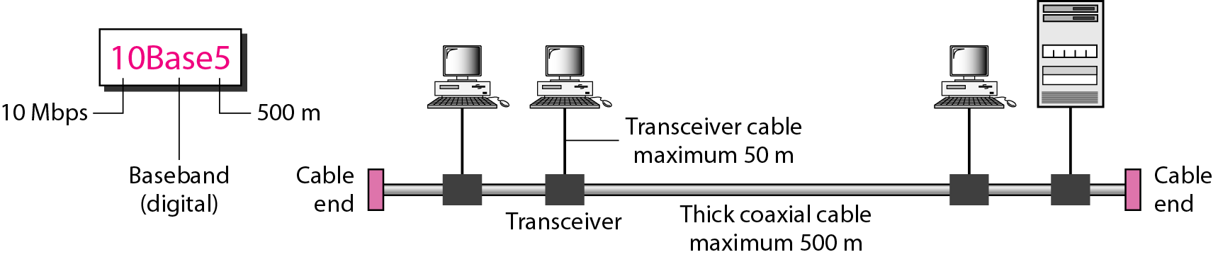
10Base5 implementation

Slide 22
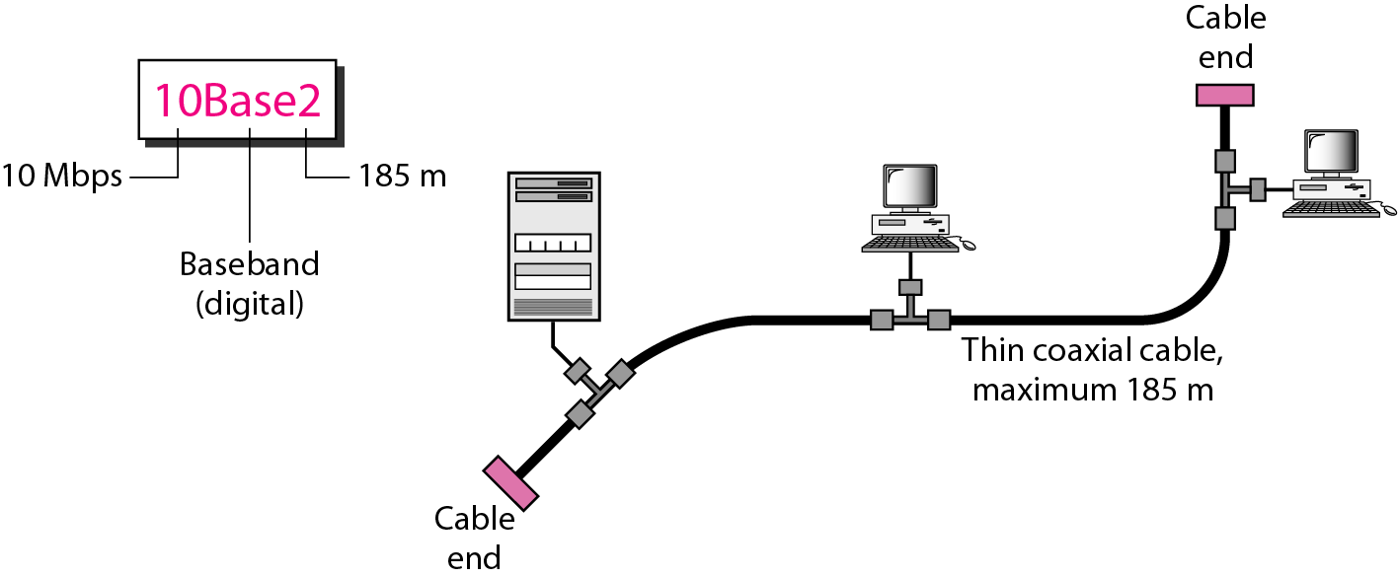
10Base2 implementation

Slide 23
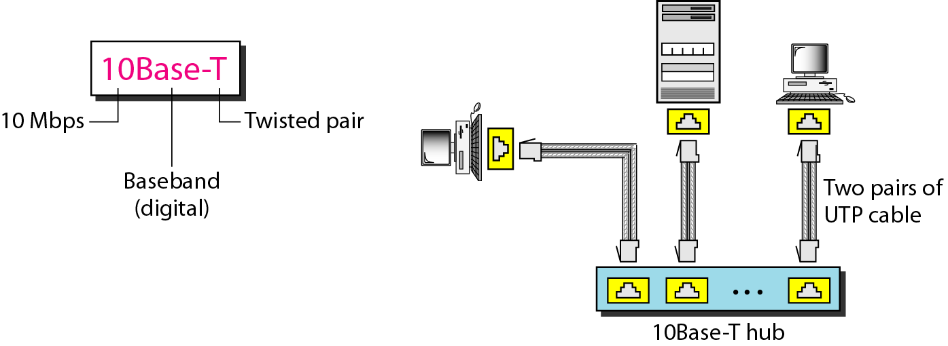
10Base-T implementation

Slide 24
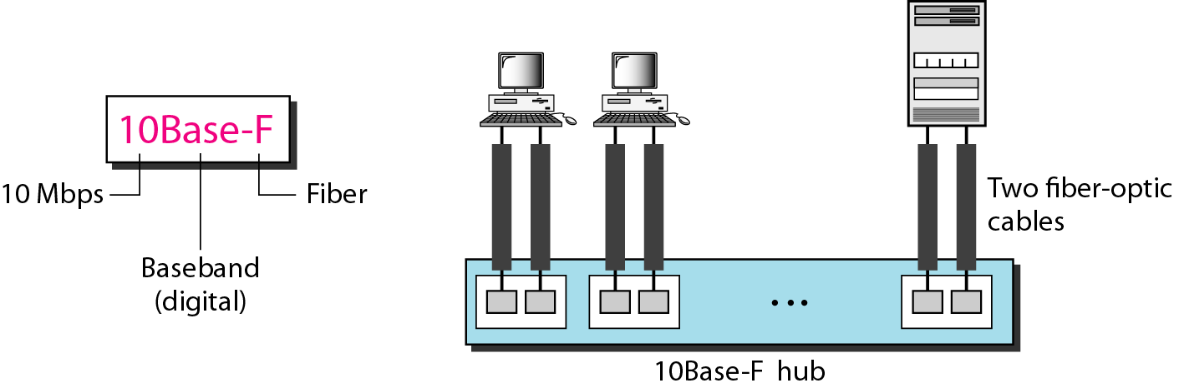
10Base-F implementation

Slide 25
Table 13.1 Summary of Standard Ethernet implementations

Slide 26
The 10-Mbps Standard Ethernet has gone through several changes before moving to the higher data rates. These changes actually opened the road to the evolution of the Ethernet to become compatible with other high-data-rate LANs.
13-3 CHANGES IN THE STANDARD
Topics discussed in this section:
Bridged Ethernet Switched Ethernet Full-Duplex Ethernet

Slide 27
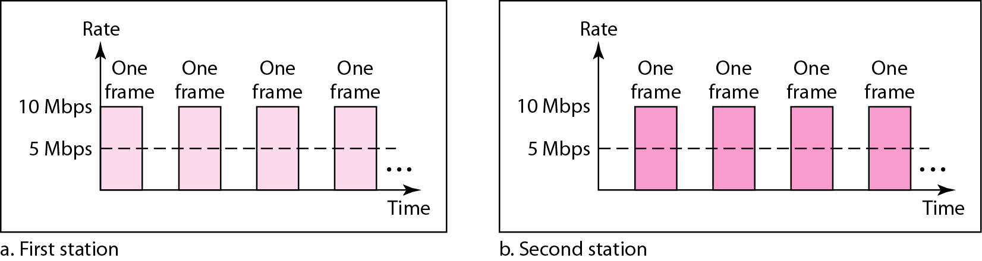
Sharing bandwidth

Slide 28
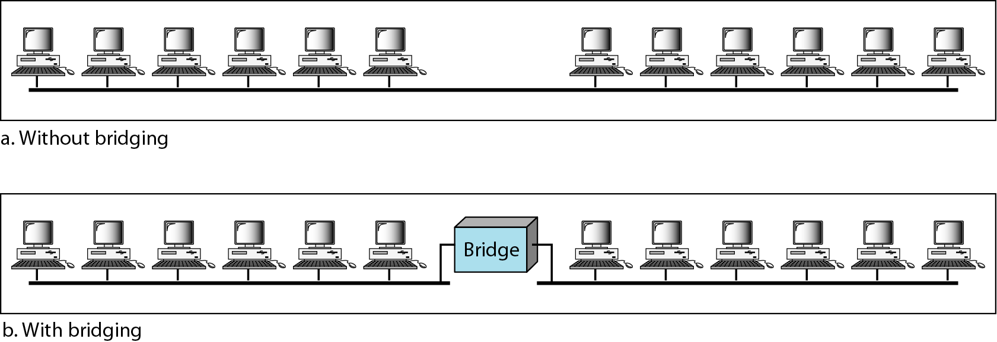
A network with and without a bridge

Slide 29
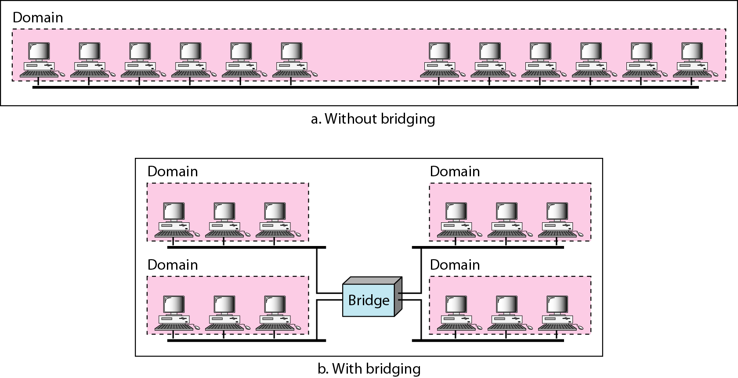
Collision domains in an unbridged network and a bridged network

Slide 30
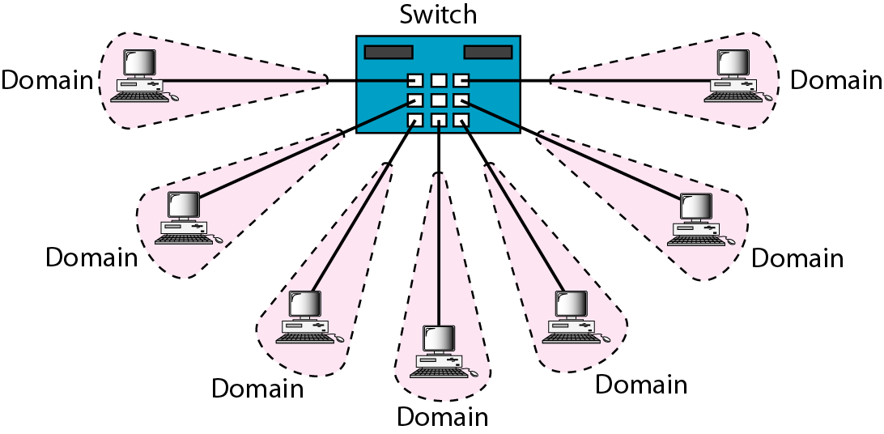
Switched Ethernet

Slide 31
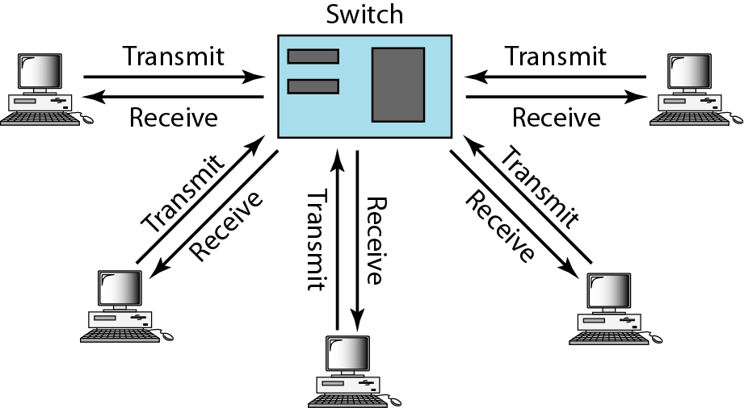
Full-duplex switched Ethernet

Slide 32
Fast Ethernet was designed to compete with LAN protocols such as FDDI or Fiber Channel. IEEE created Fast Ethernet under the name 802.3u. Fast Ethernet is backward-compatible with Standard Ethernet, but it can transmit data 10 times faster at a rate of 100 Mbps.
FAST ETHERNET
Topics discussed in this section:
MAC Sublayer Physical Layer

Slide 33
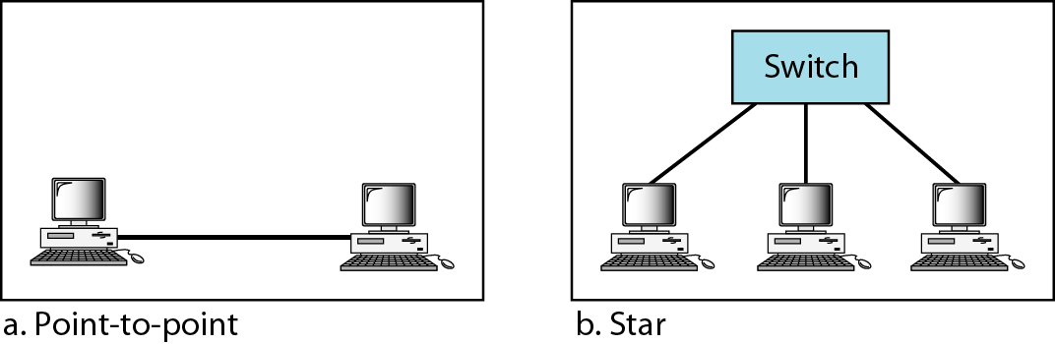
Fast Ethernet topology

Slide 34
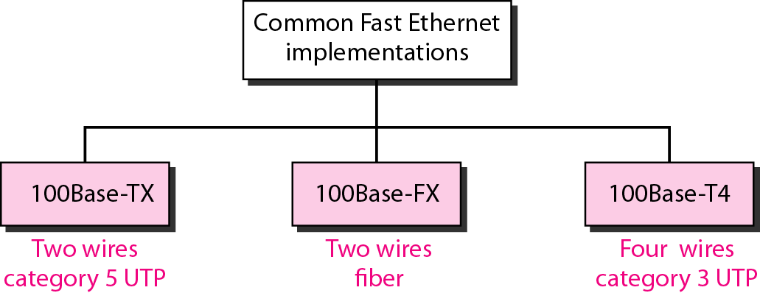
Fast Ethernet implementations

Slide 35
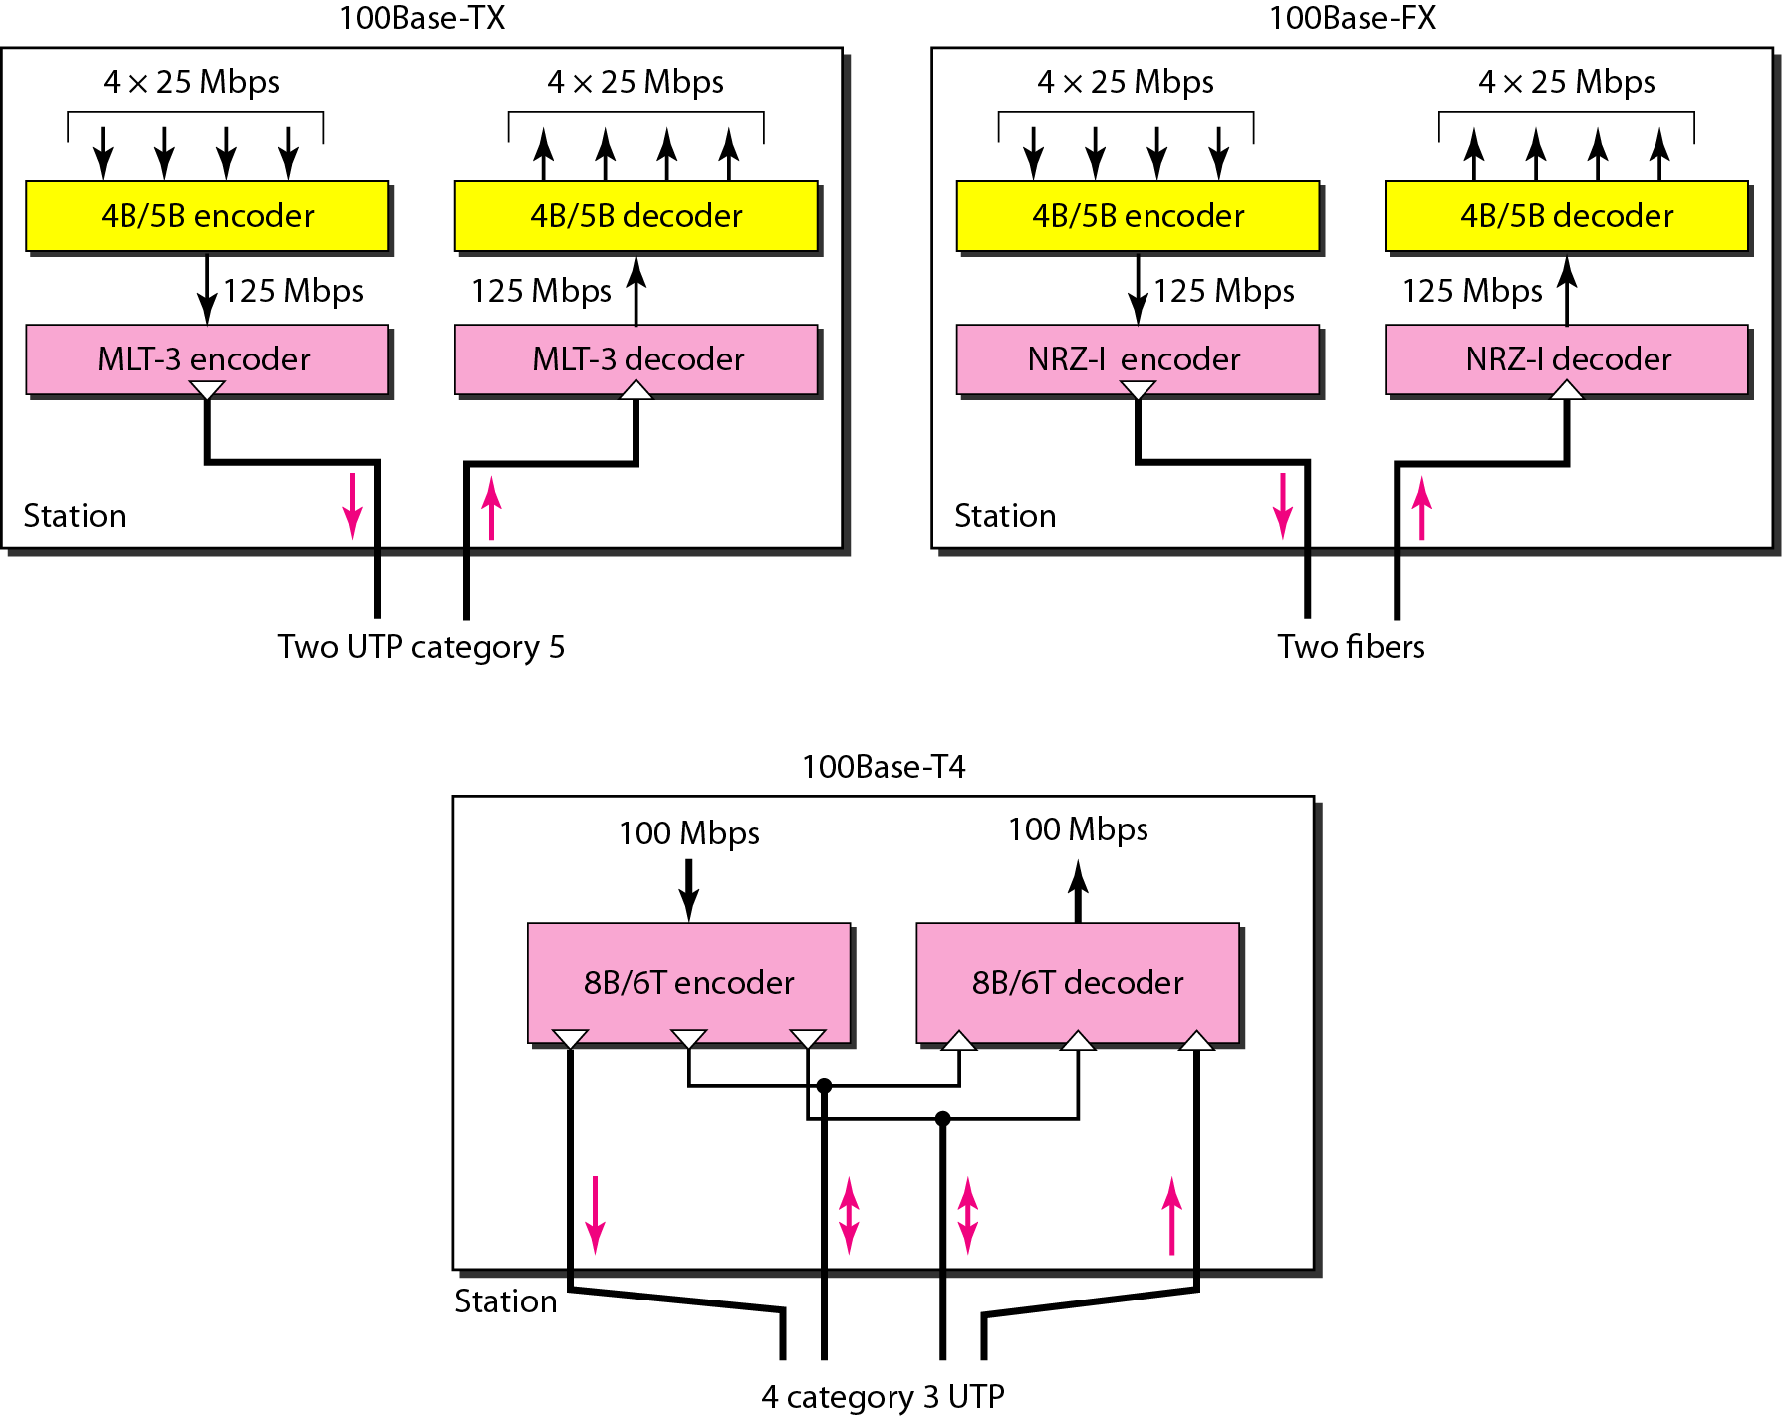
Encoding for Fast Ethernet implementation

Slide 36
Summary of Fast Ethernet implementations
Table

Slide 37
GIGABIT ETHERNET
The need for an even higher data rate resulted in the design of the Gigabit Ethernet protocol (1000 Mbps). The IEEE committee calls the standard 802.3z.
Topics discussed in this section:
MAC Sublayer Physical Layer
Ten-Gigabit Ethernet

Slide 38
Note
In the full-duplex mode of Gigabit Ethernet, there is no collision;
the maximum length of the cable is determined by the signal attenuation in the cable.

Slide 39
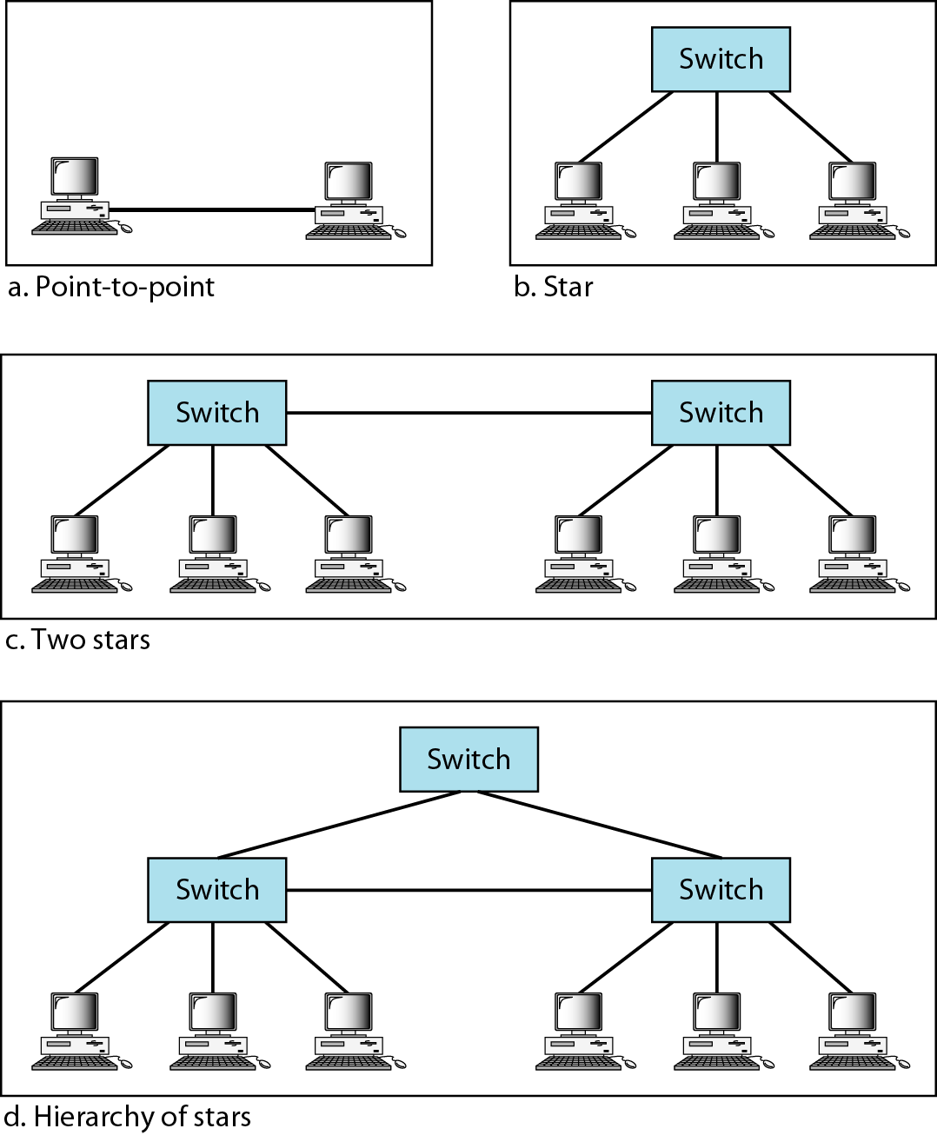

Slide 40
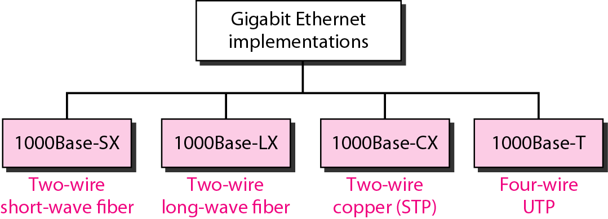
Gigabit Ethernet implementations

Slide 41
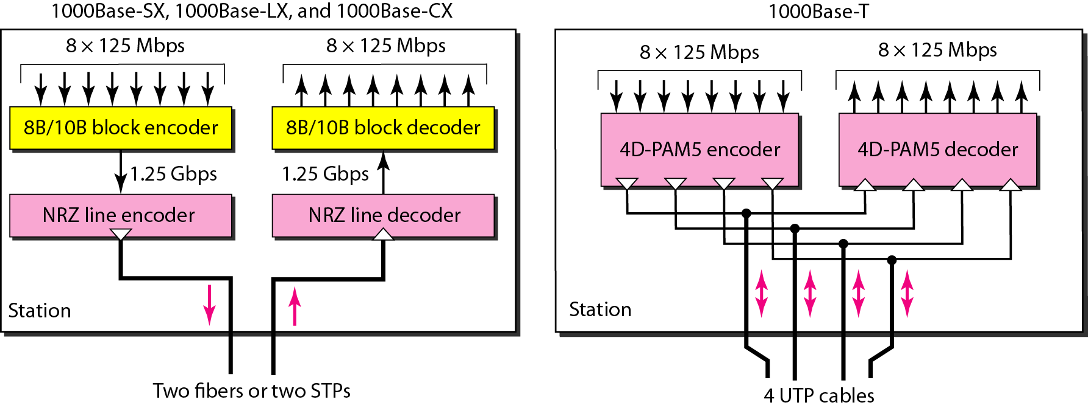
Encoding in Gigabit Ethernet implementations

Slide 42
Summary of Gigabit Ethernet implementations

Slide 43
Summary of Ten-Gigabit Ethernet implementations

